Slide 1
EIA STRATEGY - NUPRC ENGAGEMENT
Discussions on FDP and DED required as pre-condition for EIA ToR approval and Final Project EIA Approval respectively
Stanley Amam & Uju Ndibueze

Slide 2
EIA Delivery Strategy: Case for change & Prayer
Stanley
CURRENT NUPRC REQUIREMENTS:
Approved FDP and DED required as pre-condition for EIA ToR approval and Project EIA Approval respectively
CASE FOR CHANGE:
SPDC Schedule Delivery Ambition is DG1 to OSD in ca. 4 years (vs. 7+ years now) to improve the value to FGN
>60% of SPDC’s onshore gas/oil projects for the next 10+ years is wells/flowlines/tie-backs to existing facilities ca. 40-50 new wells; ca. 300 km of new flowlines/bulk lines over the period 2023-2032 in conversant terrains
Project EIA Approval is critical for FID - avoid cost & schedule creep during detailed engineering & field execution
Frozen scope (i.e., scope, route and location) endorsed by JV Partners & Regulators in early Select Phase serves as a key input in crafting the FDP
FDP approval occurs in the Front-End Engineering Design (FEED) phase ahead of Final Investment Decision (FID). Detailed Engineering Design (DED) is undertaken post early works. This is out of phase with EIA ToR and Project EIA Approval.
PRAYER:
Approval to use Concept Select Report as a pre-condition for Project EIA ToR approval and approved FDP as a pre-condition for Final Project EIA approval

Slide 3
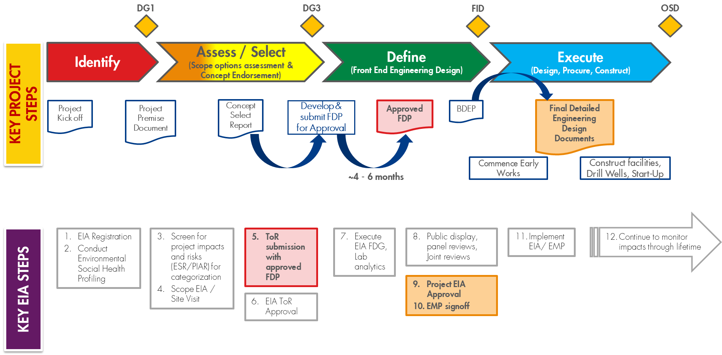
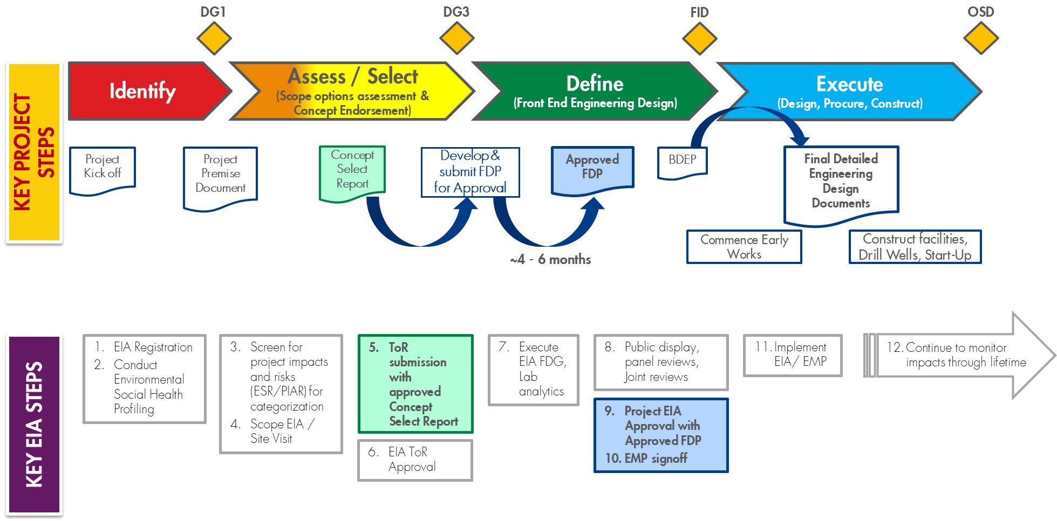
Overlay of project steps with key EIA steps over maturation period
Current State
Proposed State
Risk: Scope changes post EIA ToR Approval leading to misalignment between Final Approved FDP & Final Approved EIA
Mitigations:
Project scope (i.e., development scope, routes and locations) is frozen at Concept Select Workshop (endorsed by JV Partners & Regulators) is a critical input to the crafting FDP & EIA ToR.
Transparency of scope in EIA ToR and include additional options for field data gathering - more cost to project but ensures wider coverage
Proactive sharing of any scope changes post EIA ToR approval thru focused engagements
Approved FDP a pre-condition for Final Project EIA approval & if any significant variance, then re-engage NUPRC

Slide 4
EIA delivery strategy: Ask today
Stanley
Approval to use Concept Select Report as a pre-condition for Project EIA ToR approval and approved FDP as a pre-condition for Final Project EIA approval

Slide 6
Projects Funnel
No | Portfolio | Project | OML | Fields | ORP phase | Tentative timelines
 |  |  |  |  |  | DG3 | FID | OSD
1 | DOMGAS East | AMOR PH1A – OBELE | 22 | Obele | Select | Jun-22 | Aug-23 | Jul-26
2 |  | AMOR PH1B – RUMUEKPE DEVELOPMENT PHASE 1 | 22 | Rumuekpe | Select | Jun-22 | Aug-23 | Jul-26
3
 |  | AMOR PH2 – Appraisal | 22 | Rumuekpe | Select | Jun-22 | Aug-23 | Jul-26
4 |  | AMOR PH2 – RUMUEKPE DEVELOPMENT PHASE 2 | 22 | Rumuekpe | Select | Oct-24 | Oct-25 | Dec-26
5 | EXPORT | Epu Phase 3 | 28 | Epu | Select | Apr-23 | Nov-24 | Sep-27
6 |  | KOLO CREEK F SAND COMPRESSION | 28 | Kolo Creek | Select | Apr-22 | Jan-24 | Jan-28
7 |  | Kolobiri Development (Gbaran CPF) | 31 | Kolobiri | Select | Sep-23 | Dec-25 | Jan-28
8 | Oil Forcados | FORCADOS URBAN PLAN DEVELOPMENT Ph 1 | 45 | Forcados_ Yokri | Identify | Oct-23 | Oct-24 | Feb-27
9 |  | FURTHER FORCADOS DEVELOPMENT 1 | 45 | Forcados_ Yokri | Identify | Oct-23 | Oct-24 | Feb-27
10 |  | FORCADOS WEST | 45 | Forcados_ Yokri | Identify | Oct-23 | Oct-24 | Feb-28
11 |  | Forcados Gaslift | 45 | Forcados_ Yokri | Identify | Oct-23 | Oct-24 | Apr-29

Slide 7
Projects Funnel
No | Portfolio | Project | OML | Fields | ORP phase | Tentative timelines
 |  |  |  |  |  | DG3 | FID | OSD
12 | Oil West | SSAGS Step 3B | 35 & 46 | Agbaya, Ajatiton, Akono & Angalalei | Select | Mar-22 | Sep-24 | Oct-26
13 |  | FURTHER SSAGS DEVELOPMENT | 35 & 46 | Ogbotobo, Opomoyo, Opukushi, & Tunu | Identify | Jul-23 | Jul-24 | May-27
14 | DOMGAS West | FREEZO | 35 | Okpokunou and Tuomo | Select | Jun-22 | Aug-23 | Dec-26
15 |  | OKPOKUNOU-TUOMO WEST Phase 1 | 35 | Okpokunou | Select | Sep-22 | Sep-23 | Dec-25
16 |  | OKPOKUNOU-TUOMO WEST Phase 2 | 35 | Okpokunou | Select | Jul-22 | Nov-23 | Nov-26
17 |  | Brass Fertilizer Gas Supply Phase 1 | 32, 33, 35, 36 | Bubouwe Bou, Elepa, Seibou, Opugbene | Select | Jun-22 | Jun-23 | Jun-25
18 | Oil EA | EA (Sea Eagle) Life Extension | 79 | EA & EJA | Identify | Apr-25 | Jul-26 | Jan-28
19 |  | EA OIL & GAS DEV PH1 | 79 | EA & EJA | Identify | Apr-25 | Jul-26 | Jan-28

Slide 8
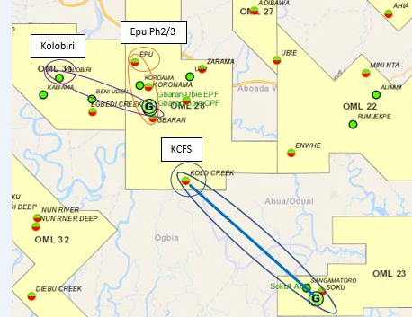
Example for Nodal EIA Map
Nodal Approach
Covering 3 projects linking to OML 28.
Kolobiri field Processing at Gbaran
EPU phase 3
KCFS with line to Soku
FIDs planned for 2024 & 2025
OSDs planned for 2027 & 2028
IDENTIFY
DEFINE
OPERATE

